Slide 1


Aguirre Facundo
17-10-2024

Slide 2

Outline
Executive Summary
Introduction
Methodology
Results
Conclusion
Appendix

Slide 3
Executive Summary
This report outlines the key findings and recommendations from our analysis of rockets launch and landing predictions based on SpaceX data. We present a summary of methodologies:
Data Collection: Initial data was gathered using the SpaceX API with the Get Request, which provided structured information on various rocket launches.
Web Scraping: Additional data was collected through web scraping from a dedicated wiki on rocket launches, allowing for comprehensive coverage of launch events.
Data Organization: The collected data underwent a thorough organization process, including data cleaning and normalization to ensure consistency and accuracy across the dataset.
Statistical Analysis: Descriptive statistics were utilized to summarize the data, and SQL was employed for querying and managing the dataset. Data visualizations were created to present findings and trends effectively.
Interactive Analysis: Interactive analyses were conducted using Folium and Plotly Dash, enabling dynamic exploration of the data and enhancing user engagement.
Predictive Analysis: Finally, a predictive analysis was performed to assess the possibility of predicting the successful landing of the first stage of rockets, based on historical launch data.

Slide 4
Executive Summary
Next we present a summary of the results of the analysis:
Launch Site and Success Rates: The majority of launches were conducted from CCAFS SLC 40, which exhibited the highest success rate among all sites, with 99 successful launches, one successful but incomplete payload, and one failure.
Payload and Flight Number Correlation: Analysis showed a positive correlation between flight number and successful landings of the first stage. Notably, even heavy payloads did not significantly affect landing success, as the first stage frequently landed successfully across various payload masses.
Payload Mass Trends: There were no launches recorded with payloads between 10,000 and 12,000 kg; most payloads ranged from 1,000 to 7,000 kg, with some near 16,000 kg.
Orbital Success Rates: The ISS orbit had the highest success rates, while the GTO orbit experienced many launches, yet only half were successful.
Geographic Considerations: Launch sites were strategically located near coastal areas and accessible roadways, ensuring necessary logistical support while maintaining safety distances from urban centers.
Predictive Modeling: Despite a limited dataset, preliminary predictive analysis indicated the feasibility of machine learning models to predict first-stage recovery with an accuracy of 83%, based on available launch data.

Slide 5
Introduction
In actuality there are a lot of companies inside the Space Race, making advances in the search for making space travel affordable for everyone. Virgin Galactic is providing suborbital spaceflights. Rocket Small is a small satellite provider for example. But there is a company that is the most successful at this moment, which is SpaceX. They advertise Falcon 9 rocket launches on its website with a cost of 62 million dollars; other providers cost upwards 165 million dollars each, much of the savings is because SpaceX can reuse the first stage. Our job is to determine the price of each launch and also determine if Space X will reuse the first stage.

Slide 6

Section 1

Slide 7
Methodology
Executive Summary
Data collection methodology:
Perform data wrangling
Perform exploratory data analysis (EDA) using visualization and SQL
Perform interactive visual analytics using Folium and Plotly Dash
Perform predictive analysis using classification models

Slide 8
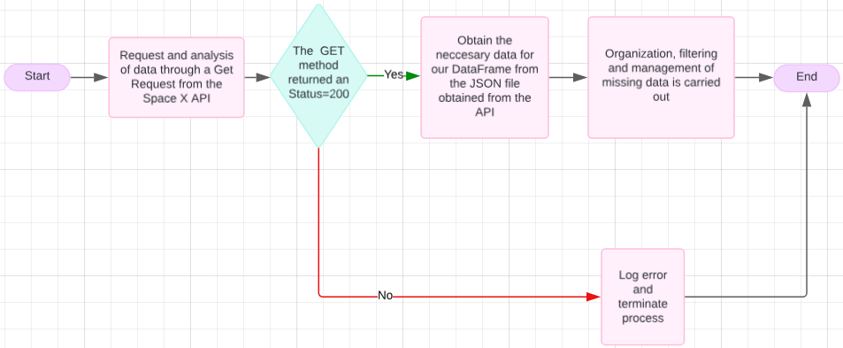
Data Collection – SpaceX API
Practical Laboratory N°1: Data Collection from the Space X API

Slide 9
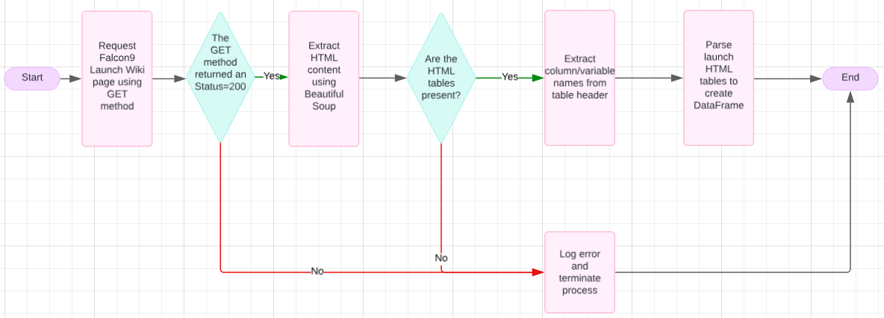
Data Collection – Scraping
Practical Laboratory N°2: Data Collection from Web Scraping

Slide 10
Data Wrangling
The data collected is processed first doing an analysis of the data set and calculate the percentage of missing values in each attribute, then we identify what type of data are the columns.
After that we use the method value_counts() on the column LaunchSite, Orbit, Outcome to determine the number of launches on each site, the number and occurrence of each orbit and to determine the number of "landing_outcomes".
Finally, using the Outcome, create a list where the element is zero if the corresponding row in Outcome is in the set bad_outcome; otherwise, it's one. Then assign it to the variable "landing_class" and calculate the success rate of landings.

Slide 11
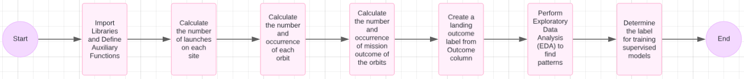
Data Wrangling
Practical Laboratory N°3: Data Wrangling

Slide 12
EDA with SQL
The queries utilized for the EDA are:
Drop table if already exists and create a new one with rows where data is not null.
Display the names of the unique launch sites in the space mission.
Display 5 records where launch sites begin with the string 'CCA'.
Display the total payload mass carried by boosters launched by NASA (CRS).
Display average payload mass carried by booster version F9 v1.1
List the date when the first succesful landing outcome in ground pad was acheived.
List the names of the boosters which have success in drone ship and have payload mass greater than 4000 but less than 6000.
List the total number of successful and failure mission outcomes.
List the names of the booster_versions which have carried the maximum payload mass using a subquery.
List the records which will display the month names, failure landing_outcomes in drone ship ,booster versions, launch_site for the months in year 2015.
Rank the count of landing outcomes (such as Failure (drone ship) or Success (ground pad)) between the date 2010-06-04 and 2017-03-20, in descending order.
Practical Laboratory N°4: EDA with SQL

Slide 13
EDA with Data Visualization
In the exploratory data analysis, a series of scatter plots were first created to verify the
existing relationships between the different columns or attributes:
FlightNumber (indicating the continuous launch attempts) and PayloadMass
FlightNumber and LaunchSite
PayloadMass and LaunchSite
FlightNumber and OrbitType
PayloadMass and OrbitType
Next, a bar chart was created to see the relationship between the success rate for each type of orbit or OrbitType.
Finally, we visualized the trend of successful launches by year with a line chart, grouping
the data by Date and Class, aggregating the average of the Class column for each year.
Practical Laboratory N°5: EDA with Data Visualization

Slide 14
Build an Interactive Map with Folium
In the building of an interactive map with Folium we created a map we marked the four different Launch Sites with "folium.Circles" and "folium.Markers" to obtain a visual representation of where they are located and possibly explain the reason for the location, also we added the Equator line with a PolyLine. Then we marked the successful and failed launches attempts for each site on the map with "MarkerCluster" which is useful for various markers having the same coordinate and have a simply way to know how much launches were successful or not for each site. Finally we added a Mouse Position to get the coordinates (Lat, Lang) of a Launch Site and created a PolyLine to mark the distance between a the LaunchSite and points like closest city, railway and highway.
Practical Laboratory N°6: Interactive Map with Folium

Slide 15
Build a Dashboard with Plotly Dash
For the Dashboard with Plotly Dash, we added the following graphs and
interactions: a list to select whether to view all launch sites simultaneously or
choose a specific one, and a callback function to render a pie chart based on the
selected launch site. This chart shows the number of successful launches if "all"
sites are chosen, or a pie chart displaying successful and failed launches for a single
selected site.
We also added a slider for selecting the payload range from 0 to 10,000 kg. Lastly,
another callback function was included to render a scatter plot where the X-axis
represents the payload and the Y-axis indicates the launch outcome (successful as 1
and failed as 0). Each point is color-coded to differentiate the type of booster used in each
launch.
Practical Laboratory N°7: Dashboard with Plotly Dash

Slide 16
Predictive Analysis (Classification)
First, we install and import the necessary libraries and define the function to create a confusion matrix. We download and assign the data to a DataFrame. Next, we convert the "Class" column into a NumPy array using the "to_numpy()" method and assign it to the variable Y, ensuring it remains a Pandas series. We then standardize the data in X and reassign it using fit_transform from StandardScaler(). After that, we use the train_test_split function to divide the data, allocating 20% for testing with random_state = 4. We then apply various machine learning methods, including Logistic Regression, Support Vector Machine, Decision Tree, and K-Nearest Neighbors. Finally, we obtain the accuracy for all models and optimize the hyperparameters using GridSearchCV.

Slide 17
Predictive Analysis (Classification)
Practical Laboratory N°8: Predictive Analysis

Slide 18
Results
The exploratory data analysis revealed that most rocket launches were conducted from CCAFS
SLC 40, with a majority resulting in successful landings. The first launch occurred on December 22, 2015, and
the data indicated 99 successful launches, one successful but incomplete payload, and one failure, with an
average payload of 2534.66 kg.
Visualizations showed a positive correlation between flight number and successful landings of the first stage,
with payload mass also being a contributing factor. There were no launches with payloads between 10,000 and
12,000 kg; most were between 1,000 and 7,000 kg. The ISS had the highest success rates, while GTO orbit saw
many attempts with only half being successful.
The Folium map illustrated that launch sites are strategically located near the coast and accessible roads,
ensuring safe distances from cities for security. The interactive dashboard highlighted that CCAFS LC 40 had the
highest success rate and number of launches, with a correlation between payload and success
based on booster versions.
Lastly, despite the small dataset, predictive analysis showed the potential to create machine learning models
that could accurately predict (83%) whether the first stage would successfully land based on available data.

Slide 19

Section 2

Slide 20
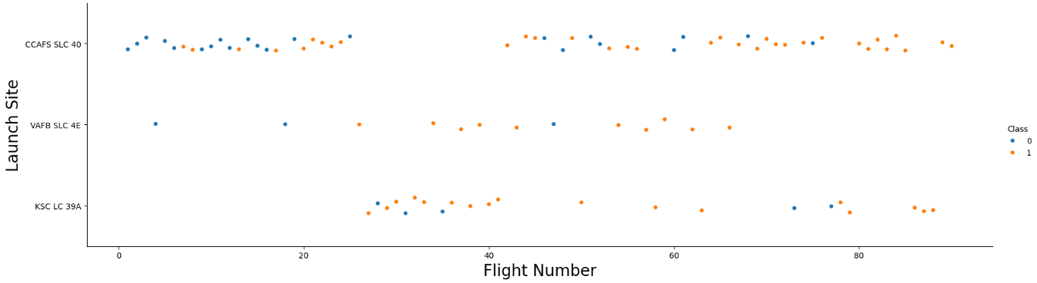
Flight Number vs. Launch Site
In this graphic, we can observe that the most launches were conducted at CCAFS SLC 40, and it seems that the majority were successful attempts. Additionally, we see that the fewest launch attempts were made at VAFB SLC 4E, where 14 launches occurred and 10 were successful.

Slide 21
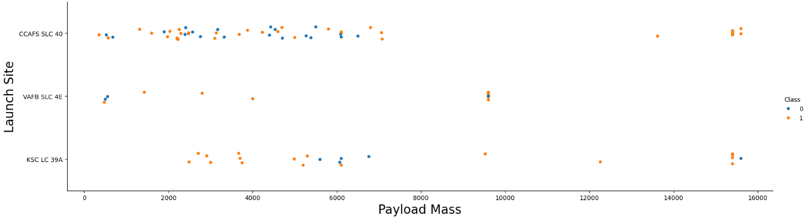
Payload vs. Launch Site
In this graphic we can find for the VAFB-SLC 4E launch site there are no rockets launched for heavy payload mass(greater than 10000).

Slide 22
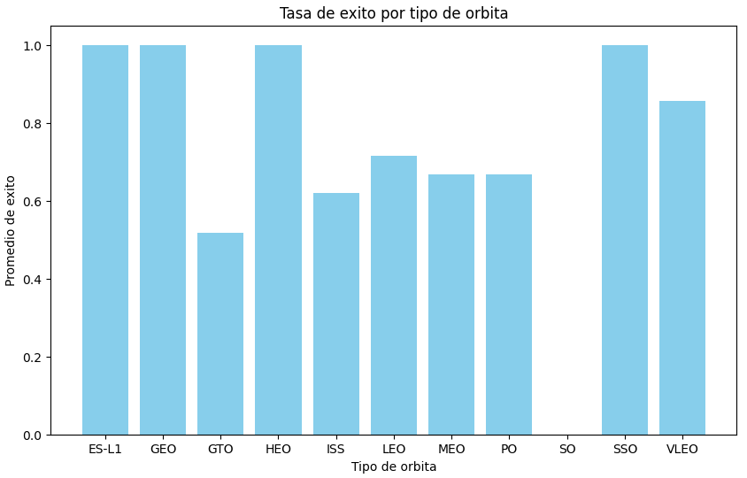
Success Rate vs. Orbit Type
In this graphic we can observe that the Orbit Type with the most successful launches were ES-L1, GEO, HEO and SSO, with the least successful being GTO.

Slide 23
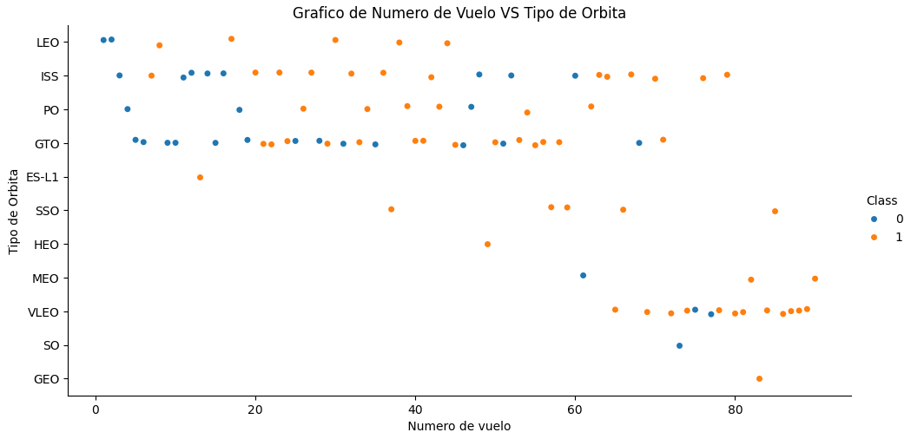
Flight Number vs. Orbit Type
In this graphic we can observe the number of flights, their orbit type and the result of each one. The launch attempts were made initially in the orbits like LEO, ISS, PO and GTO, and the last attempts were made in their majority on VLEO orbit where most of them were successful.

Slide 24
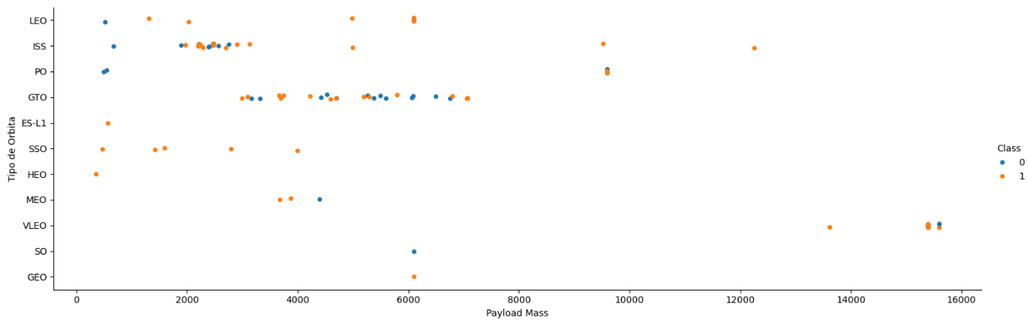
Payload vs. Orbit Type
In this graphic we observe that with heavy payloads the successful landing or positive landing rate are more for Polar, LEO and ISS. However, for GTO, it's difficult to distinguish between successful and unsuccessful landings as both outcomes are present.

Slide 25
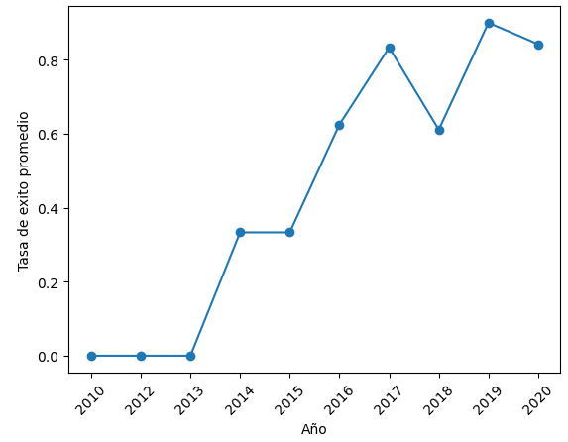
Launch Success Yearly Trend
In this graphic we can observe that the year with the most successful launch attempts were in 2019.

Slide 26
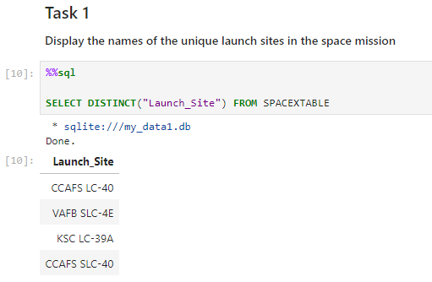
All Launch Site Names
Here the result is a table with the unique names in the column 'Launch_Site'

Slide 27
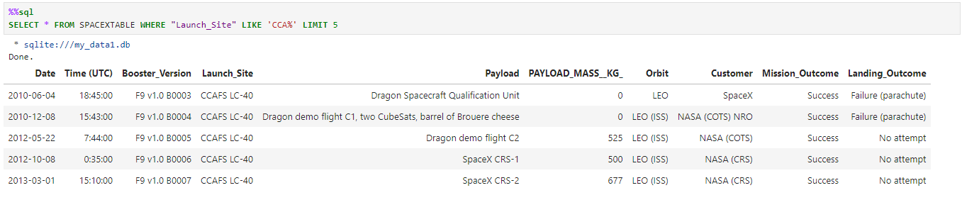
Launch Site Names Begin with 'CCA'
Here the result is the table limited to 5 rows where the name of the launch site starts with the string CCA.

Slide 28
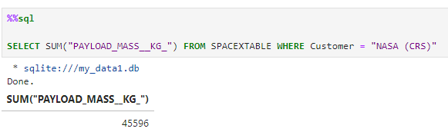
Total Payload Mass
Here we realize a query to calculate the total payload mass in kg for the customer NASA (CRS)

Slide 29
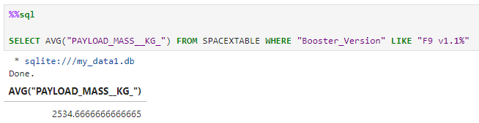
Average Payload Mass by F9 v1.1
Here the result show the average payload mass for the booster version F9 v1.1

Slide 30
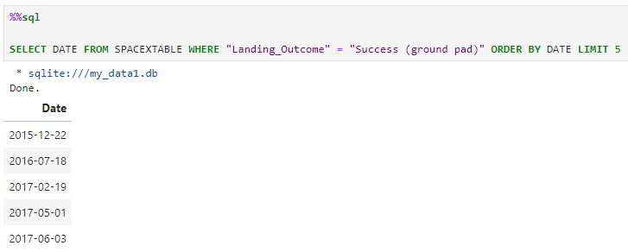
First Successful Ground Landing Date
Here the result show a list of 5 rows with the date of the launches in ascending order for the landings resulted in success on a ground pad to see the first successful ground landing date.

Slide 31
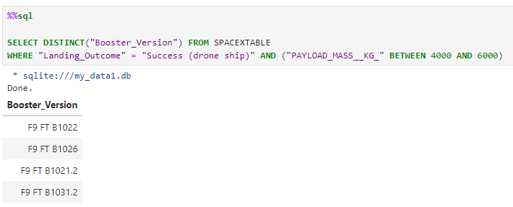
Successful Drone Ship Landing with Payload between 4000 and 6000
Here the result of the query is a list of all the booster versions where the landing outcome was successful on a drone ship and the payload mass was between 4000 and 6000 Kg.

Slide 32
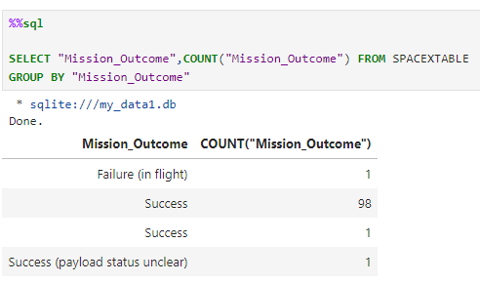
Total Number of Successful and Failure Mission Outcomes
Here the result of the query show a list of the different mission outcomes and the count to see the number of successful and failure missions. (Note that there is two result named "Success", after downloading the csv we observed that the data came with one row with the mission outcome as "Success " with an empty space, that is the reason for SQL to count it as a different Outcome)

Slide 33
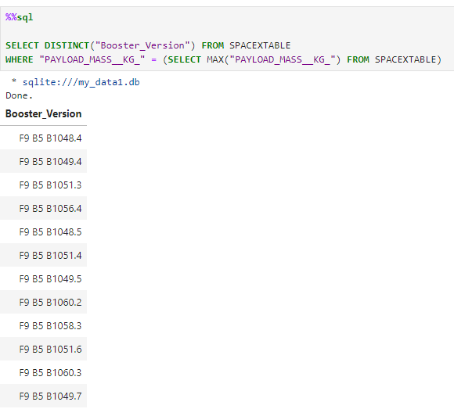
Boosters Carried Maximum Payload
Here the query shows a list of boosters_version which have carried the maximum payload mass, we obtain this using a subquery to calculate the max payload mass.

Slide 34
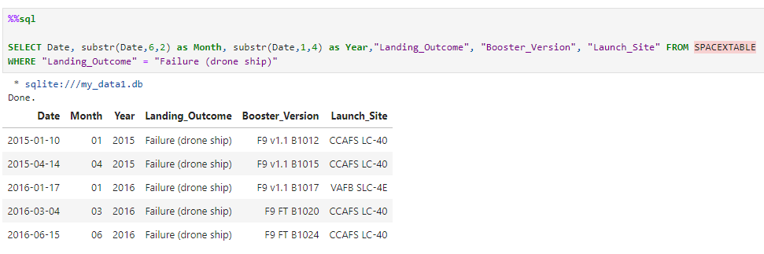
2015 Launch Records
Here the result show a table with the date, then we extract the month and the year from it, we also have the landing outcome, booster version and launch site only where the landing outcome was a failure on a drone ship.

Slide 35
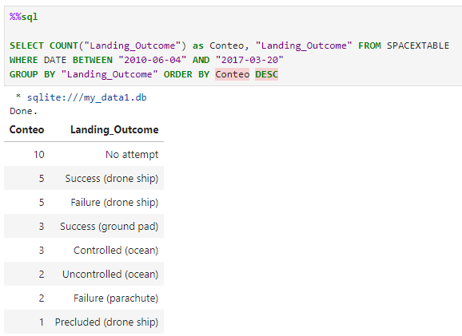
Rank Landing Outcomes Between 2010-06-04 and 2017-03-20
Here the result is a table with landing outcomes and the count for each category to generate a ranking only with the launches realized between 2010-06-04 and
2017-03-20

Slide 36

Section 3

Slide 37
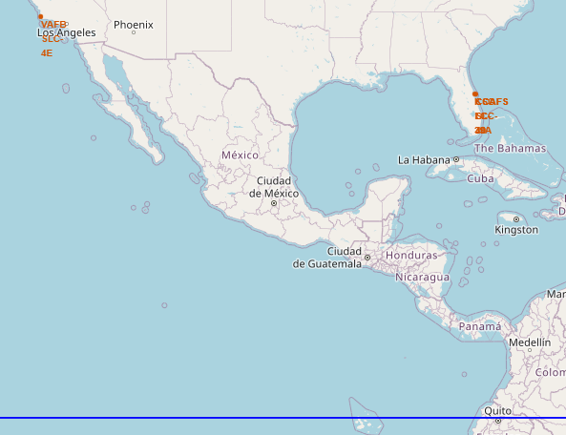
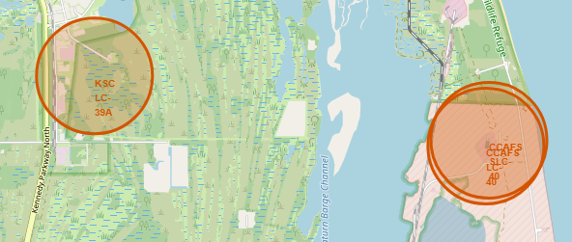
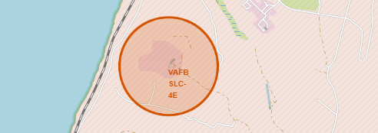
Launch Sites
The screenshot on the left show all launch sites zoomed out and the equator line to observe the distance. The other two screenshots are the launch sites zoomed in to observe where they are located

Slide 38
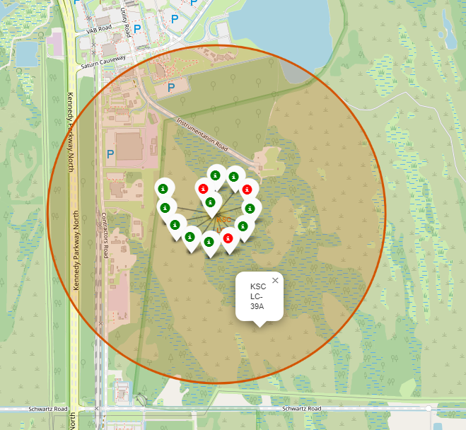
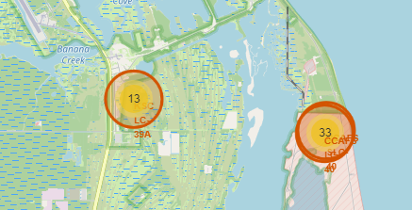
Labeled Launch Sites
The screenshot on the left show launch sites zoomed out with a number of launch attemps. The one in the right show the site KSC LC-39A with labels for each launch and a color, green for successful and red for failure.

Slide 39
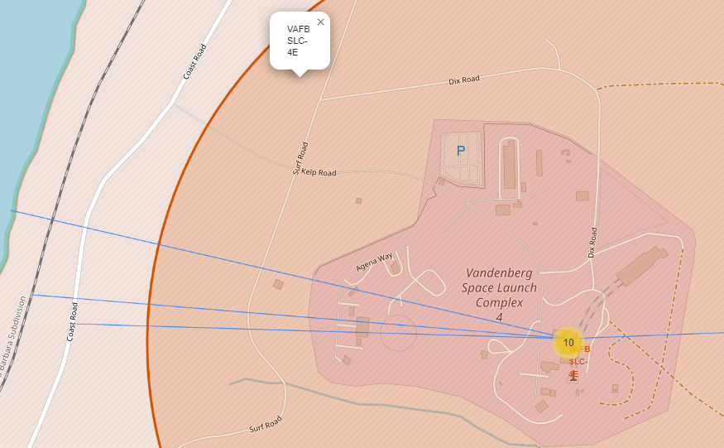
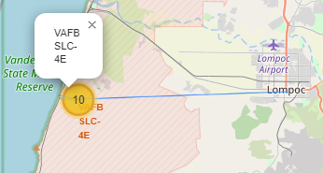
Labeled Launch Sites
The screenshot on the left show the site VAFB SLC-4E and a line to measure the distance between the site and the closest city. The one on the right show lines to the closest Coast Road, Highway and Coast Line. We observe that a launch site is usually ubicated close to this roads and away from cities.

Slide 40

Section 4

Slide 41
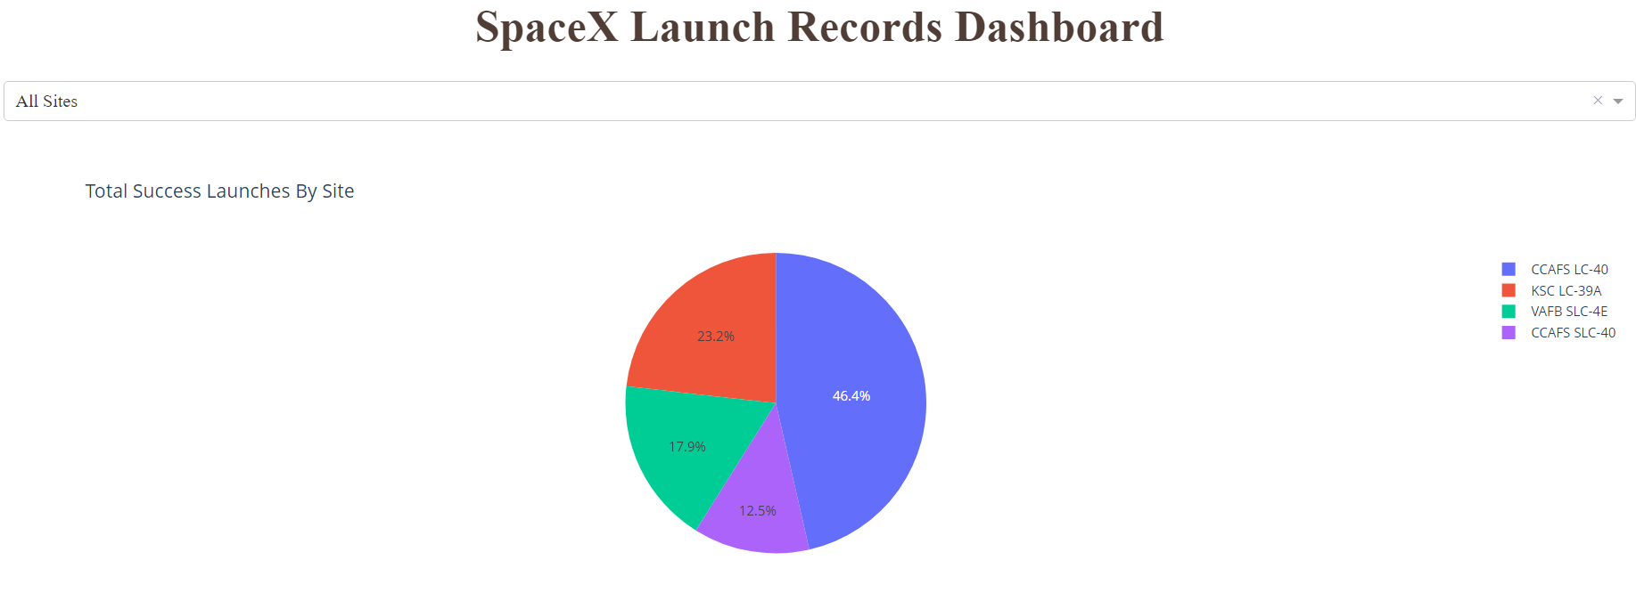
Pie Chart for all Launch Sites
We can use this pie chart to see the number of launches conducted at all launch sites, both as a percentage of the total and as the total number for each site.

Slide 42
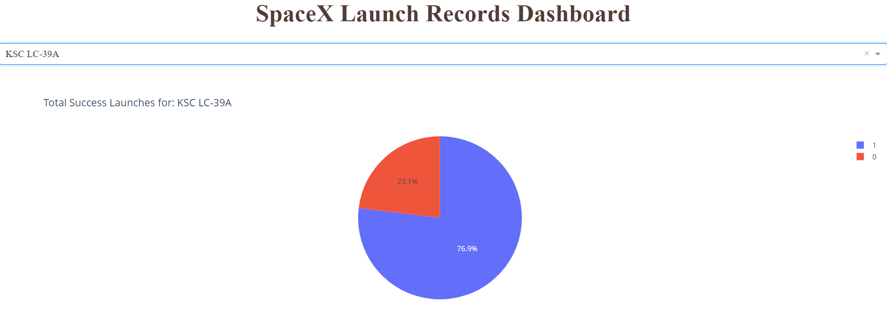
Launch Site with the highest ratio of Success
We use this chart to see the launch site which made the most successful ratio of attempts so we can compare it to the others individually.

Slide 43
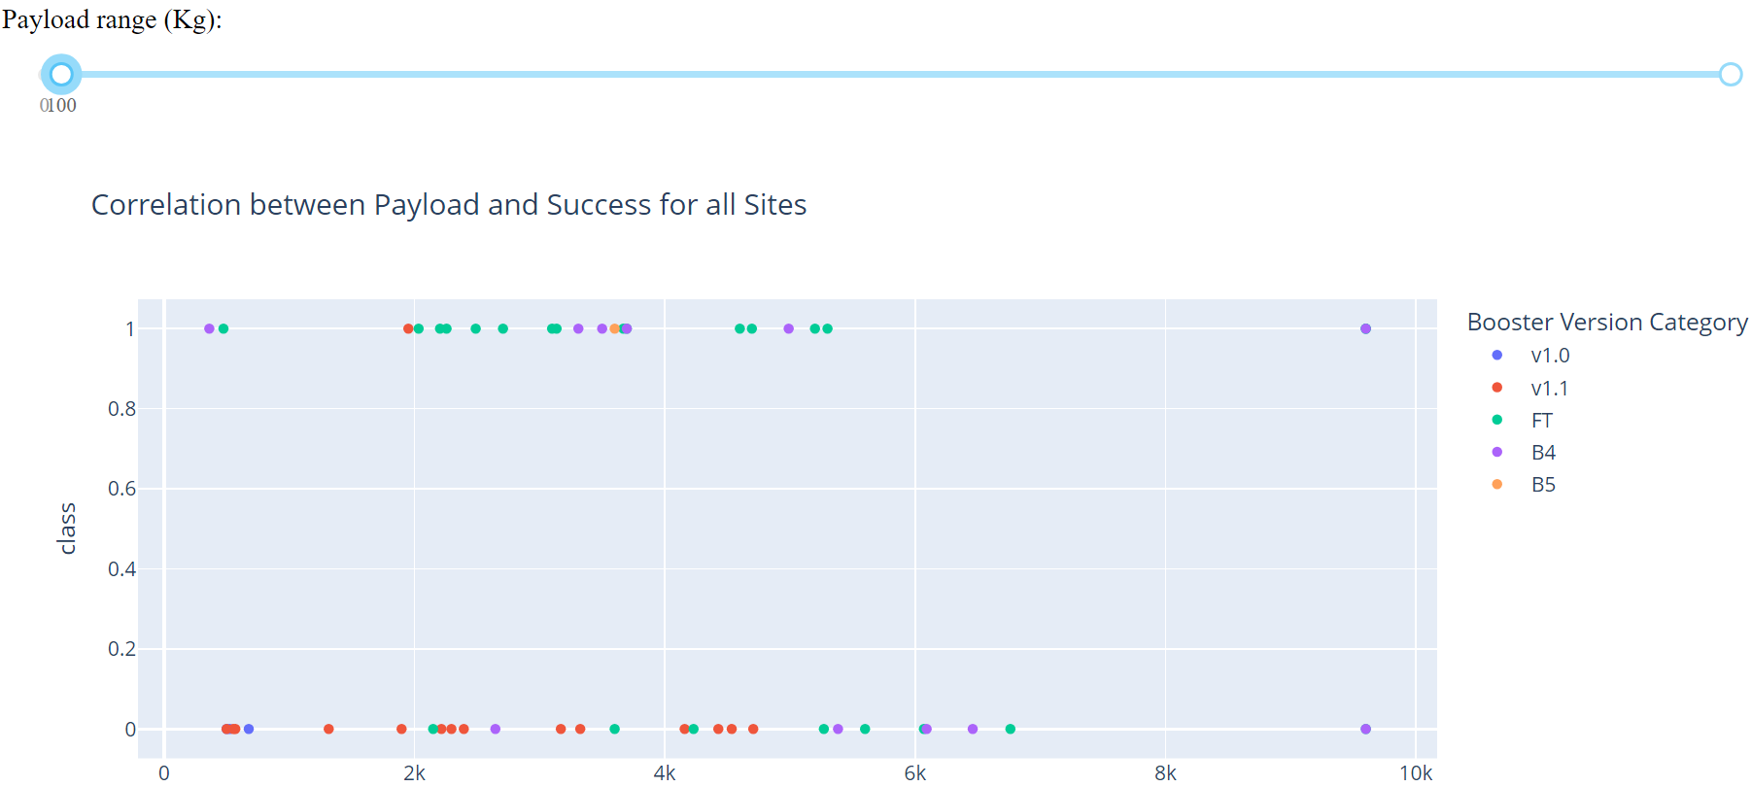
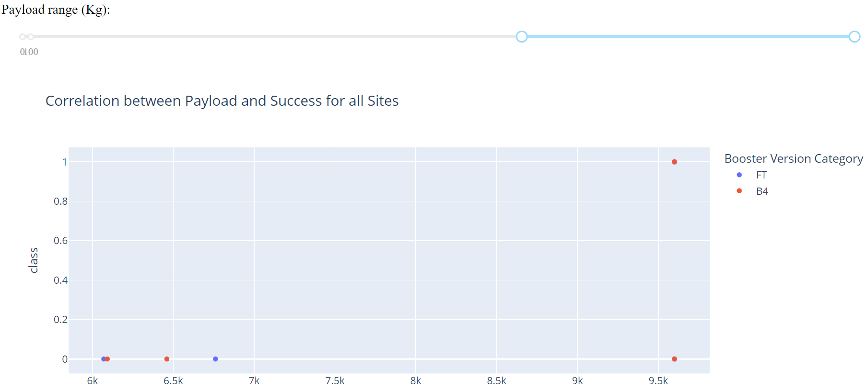
Scatter Chart for Payload vs Launch Outcome
We use this chart to select the range of the payload and observe with different values of payload mass the result of launches for each booster version.

Slide 44

Section 5

Slide 45
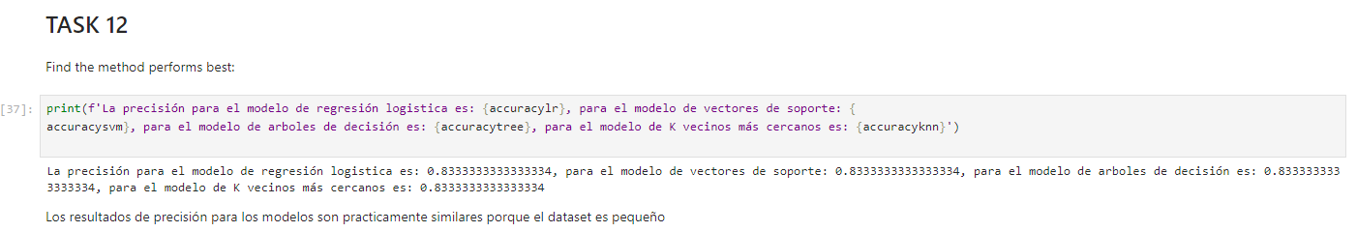
Classification Accuracy
As noted in the markdown, the accuracy of all the classification models are practically the same, one of the reasons is because of the size of the dataset being too small.

Slide 46
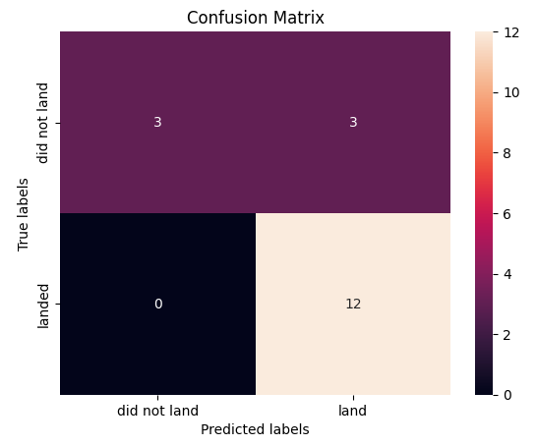
Confusion Matrix
Examining the confusion matrix, we see that logistic regression can distinguish between the​ different classes. We see that the problem is false positives. Note that as accuracy, the confusion​ matrix is practically the same.

Slide 47
From the exploratory data analysis, we obtained various results. Initially, we know that most launches were conducted from the CCAFS SLC 40 site, and the majority of outcomes were successful landings on a ground pad. The first launch took place on December 22, 2015. Some interesting data we obtained from SQL queries show that there were 99 successful rocket launches, 1 successful launch with the payload status incomplete, and 1 failure. The average payload transported by the rockets is 2534.66 kg.
From the analysis of visualizations, we can first observe the relationships between the different variables. For example, the relationship between flight number and payload mass indicates that as the flight number increases, the first stage is more likely to land successfully. Payload mass also seems to be a factor; even with heavy payloads, the first stage almost always lands successfully. Notably, there were no launches with payload mass between 10,000 and 12,000 kg, with most concentrated in the range of 1,000 to 7,000 kg, and some launches around 16,000 kg. The types of orbits with the highest success rates and the greatest number of launches to consider are ISS, with many attempts in GTO orbit, but only half of those flights were successful.
From the Folium map, we can see the locations of the various launch sites. It is easy to recognize that they are all near the coast, as well as accessible by roads that can connect the sites for supplying necessary elements like personnel and materials. Another detail is that they are also located at a safe distance from other cities for security reasons.
From our interactive dashboard, we obtain several results: the site with the highest success rate is CCAFS LC-40 when comparing all sites. Individually, it is the site with the highest number of launches. We can also observe the correlation that exists between payload and success for all launches, color-coded depending on the version of the booster.
Finally, from the predictive analysis, although in this case the provided dataset is small, we can see that it is possible to create several machine learning models to detect with considerable accuracy (83%) whether the first stage will be recovered through a successful landing based on the other data.
Conclusions

Slide 48


